Slide 1
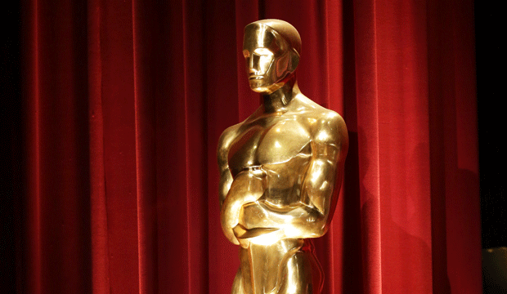
Movies Business Analysis

Slide 2

WE DON’T MAKE MOVIES TO MAKE MORE MONEY. WE MAKE MONEY TO MAKE MORE MOVIES
-- Walt Disney

Slide 3
Motivation
Lifting the 35 year ban on cinemas is one of the most visible and impactful initiatives that has taken place in Saudi
One of the QoL's metrics is to develop the local film industry with the goal of producing 13 Saudi movies by 2020. --PWC
The Saudi cinema industry has the potential to generate total revenue of USD 1.5 billion in 2030 and develop into a lucrative revenue stream for the industry players and the government. --PWC

Slide 4
There are several questions we are trying to answer:-
1) What contributes to a movie’s success
2) Is profit associated with movies achieving awards
3) Is there a legit metric to winning the Oscar

Slide 5


Data Sources

Slide 6
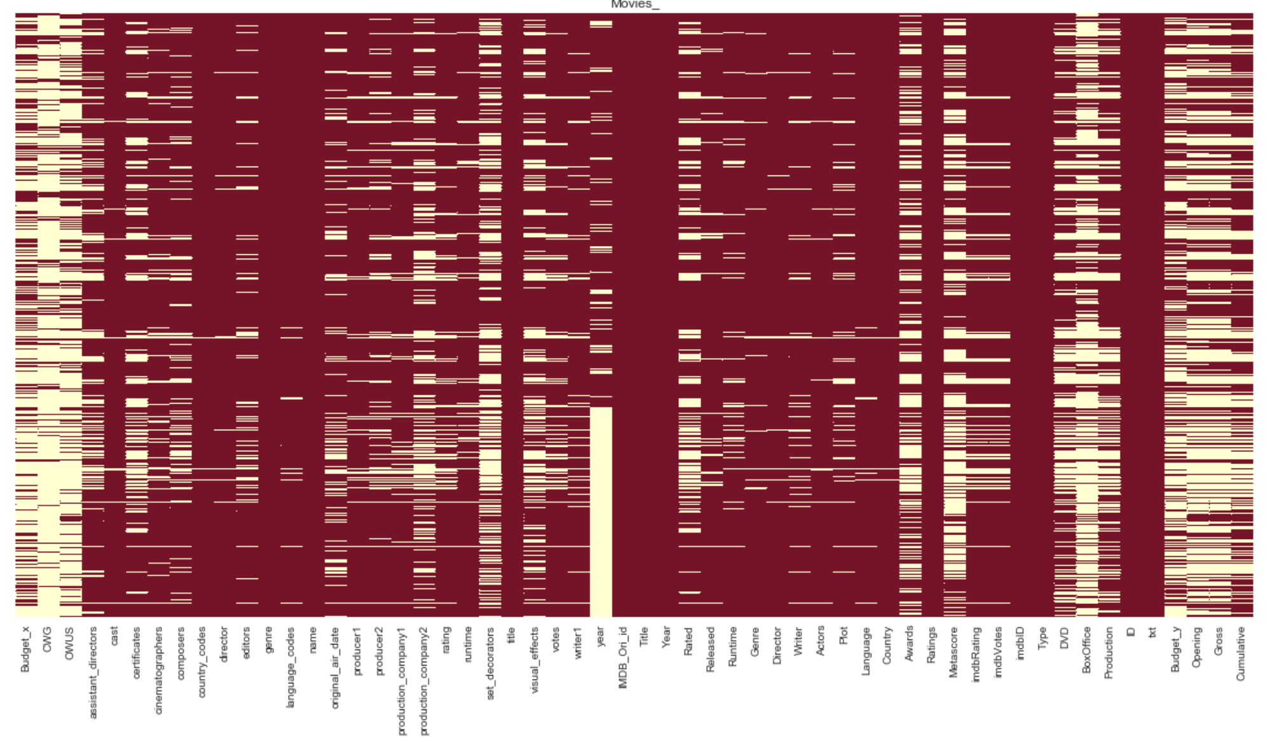
What we had !

Slide 7
Dealing with missing values:
Using different data sources to fill missing values.
Filling missing values in different columns as follows:
Production company
Runtime
Certificates
Rating and Votes
Language & country
Month
Fill missing value with (other)
Predict using regression models
Fill with runtime average of the same genre
Fill with mode of the same genre
Fill with 0
Fill with the majority value.
Choose randomly between top 3 months.
Budget

Slide 8
Removing unwanted columns
Fixing some values format:
Year
Genre
Finances
Certificate
Cast
Converting to Date-Time Format
Splitting the genres into multiple columns to reduce redundancy
Removing symbols, calculating currency using Forex API
Mapping the rating to the US rating system
Removing tags and fixing the format to get names

Slide 9
Adding new columns:
Split date
Date
08 Apr 2019

Slide 10
Adding new columns:
Split date
Date
08 Apr 2019

Slide 11
Adding new columns:
Split date
Date
08 Apr 2019
Month
Year
Apr
2019

Slide 12
Adding new columns:
Country
Country
[UK, CA]

Slide 13
Adding new columns:
Country
Country
[UK, CA]
Include US
Multi country
0
2

Slide 14
Dealing with categorical data:
Genre
Production company
Convert to columns, add 1 for movies of this type, otherwise add 0
Take top 15 and added other, then get dummies
Replace with representative weight
Certificate
Get dummies
Crew names

Slide 15
Replace the names of crew with representative weight that calculated as follows:
Movie Name | Year | Actor 1 | Actor 2 | Director
The Lake House | 2006 | Sandra Bullock | Keanu Reeves | Alejandro Agresti
Gladiator | 2000 | Russell Crowe | Joaquin Phoenix | Ridley Scott
Frozen | 2013 | Kristen Bell | Idina Menzel | Chris Buck
matrix of awards
matrix of nominations
calculate the weight
Name | 2003 | 2004 | 2006 | 2007 | 2008
Josh Gad | 0 | 1 | 2 | 2 | 2
Sandra Bullock | 0 | 0 | 1 | 1 | 1
Nicolas Cage | 4 | 4 | 5 | 5 | 5
Dean Norris | 2 | 2 | 3 | 3 | 4
Sue Rock | 0 | 1 | 1 | 2 | 3
Name | 2003 | 2004 | 2006 | 2007 | 2008
Josh Gad | 3 | 5 | 6 | 6 | 6
Sandra Bullock | 1 | 1 | 2 | 3 | 3
Nicolas Cage | 6 | 6 | 7 | 7 | 9
Dean Norris | 3 | 4 | 5 | 6 | 6
Sue Rock | 1 | 2 | 3 | 3 | 4
Winning # *1
+
Nominated # * .5

Slide 16
Replace the names of crew with representative weight that calculated as follows:
Movie Name | Year | Actor 1 | Actor 2 | Director
The Lake House | 2006 | Sandra Bullock | Keanu Reeves | Alejandro Agresti
Gladiator | 2000 | Russell Crowe | Joaquin Phoenix | Ridley Scott
Frozen | 2013 | Kristen Bell | Idina Menzel | Chris Buck
matrix of awards
matrix of nominations
calculate the weight
Name | 2003 | 2004 | 2006 | 2007 | 2008
Josh Gad | 0 | 1 | 2 | 2 | 2
Sandra Bullock | 3 | 3 | 4 | 5 | 5
Nicolas Cage | 4 | 4 | 5 | 5 | 5
Dean Norris | 2 | 2 | 3 | 3 | 4
Sue Rock | 0 | 1 | 1 | 2 | 3
Name | 2003 | 2004 | 2006 | 2007 | 2008
Josh Gad | 3 | 5 | 6 | 6 | 6
Sandra Bullock | 1 | 1 | 2 | 3 | 3
Nicolas Cage | 6 | 6 | 7 | 7 | 9
Dean Norris | 3 | 4 | 5 | 6 | 6
Sue Rock | 1 | 2 | 3 | 3 | 4
Winning # *1
+
Nominated # * .5

Slide 17
Replace the names of crew with representative weight that calculated as follows:
Movie Name | Year | Actor 1 | Actor 2 | Director
The Lake House | 2006 | Sandra Bullock | Keanu Reeves | Alejandro Agresti
Gladiator | 2000 | Russell Crowe | Joaquin Phoenix | Ridley Scott
Frozen | 2013 | Kristen Bell | Idina Menzel | Chris Buck
matrix of awards
matrix of nominations
calculate the weight
Name | 2003 | 2004 | 2006 | 2007 | 2008
Josh Gad | 0 | 1 | 2 | 2 | 2
Sandra Bullock | 3 | 3 | 4 | 5 | 5
Nicolas Cage | 4 | 4 | 5 | 5 | 5
Dean Norris | 2 | 2 | 3 | 3 | 4
Sue Rock | 0 | 1 | 1 | 2 | 3
Name | 2003 | 2004 | 2006 | 2007 | 2008
Josh Gad | 3 | 5 | 6 | 6 | 6
Sandra Bullock | 6 | 8 | 9 | 9 | 9
Nicolas Cage | 6 | 6 | 7 | 7 | 9
Dean Norris | 3 | 4 | 5 | 6 | 6
Sue Rock | 1 | 2 | 3 | 3 | 4
Winning # *1
+
Nominated # * .5

Slide 18
Replace the names of crew with representative weight that calculated as follows:
Movie Name | Year | Actor 1 | Actor 2 | Director
The Lake House | 2006 | Sandra Bullock | Keanu Reeves | Alejandro Agresti
Gladiator | 2000 | Russell Crowe | Joaquin Phoenix | Ridley Scott
Frozen | 2013 | Kristen Bell | Idina Menzel | Chris Buck
matrix of awards
matrix of nominations
calculate the weight
Name | 2003 | 2004 | 2006 | 2007 | 2008
Josh Gad | 0 | 1 | 2 | 2 | 2
Sandra Bullock | 3 | 3 | 4 | 5 | 5
Nicolas Cage | 4 | 4 | 5 | 5 | 5
Dean Norris | 2 | 2 | 3 | 3 | 4
Sue Rock | 0 | 1 | 1 | 2 | 3
Name | 2003 | 2004 | 2006 | 2007 | 2008
Josh Gad | 3 | 5 | 6 | 6 | 6
Sandra Bullock | 6 | 8 | 8 | 8 | 8
Nicolas Cage | 6 | 6 | 7 | 7 | 9
Dean Norris | 3 | 4 | 5 | 6 | 6
Sue Rock | 1 | 2 | 3 | 3 | 4
Winning # *1
+
Nominated # * .5

Slide 19
Replace the names of crew with representative weight that calculated as follows:
Movie Name | Year | Actor 1 | Actor 2 | Director
The Lake House | 2006 | Sandra Bullock | Keanu Reeves | Alejandro Agresti
Gladiator | 2000 | Russell Crowe | Joaquin Phoenix | Ridley Scott
Frozen | 2013 | Kristen Bell | Idina Menzel | Chris Buck
matrix of awards
matrix of nominations
calculate the weight
Name | 2003 | 2004 | 2006 | 2007 | 2008
Josh Gad | 0 | 1 | 2 | 2 | 2
Sandra Bullock | 3 | 3 | 4 | 5 | 5
Nicolas Cage | 4 | 4 | 5 | 5 | 5
Dean Norris | 2 | 2 | 3 | 3 | 4
Sue Rock | 0 | 1 | 1 | 2 | 3
Name | 2003 | 2004 | 2006 | 2007 | 2008
Josh Gad | 3 | 5 | 6 | 6 | 6
Sandra Bullock | 6 | 8 | 9 | 9 | 9
Nicolas Cage | 6 | 6 | 7 | 7 | 9
Dean Norris | 3 | 4 | 5 | 6 | 6
Sue Rock | 1 | 2 | 3 | 3 | 4
4*1
+
9* .5
=
8.5

Slide 20
Replace the names of crew with representative weight that calculated as follows:
Movie Name | Year | Actor 1 | Actor 2 | Director
The Lake House | 2006 | 8.5 | Keanu Reeves | Alejandro Agresti
Gladiator | 2000 | Russell Crowe | Joaquin Phoenix | Ridley Scott
Frozen | 2013 | Kristen Bell | Idina Menzel | Chris Buck
matrix of awards
matrix of nominations
calculate the weight
Name | 2003 | 2004 | 2006 | 2007 | 2008
Josh Gad | 0 | 1 | 2 | 2 | 2
Sandra Bullock | 3 | 3 | 4 | 5 | 5
Nicolas Cage | 4 | 4 | 5 | 5 | 5
Dean Norris | 2 | 2 | 3 | 3 | 4
Sue Rock | 0 | 1 | 1 | 2 | 3
Name | 2003 | 2004 | 2006 | 2007 | 2008
Josh Gad | 3 | 5 | 6 | 6 | 6
Sandra Bullock | 6 | 8 | 9 | 9 | 9
Nicolas Cage | 6 | 6 | 7 | 7 | 9
Dean Norris | 3 | 4 | 5 | 6 | 6
Sue Rock | 1 | 2 | 3 | 3 | 4
4*1
+
9* .5
=
8.5

Slide 21
Movie’s Success indicators
Revenue
Popularity
Wining awards
Audience rating

Slide 22
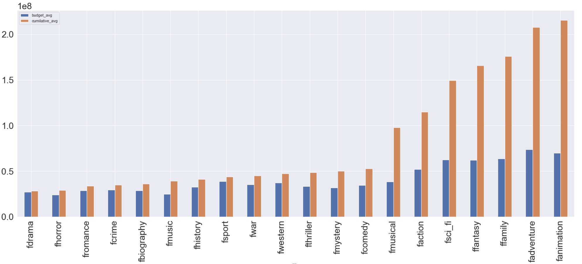
Revenue
Genre effect

Slide 23
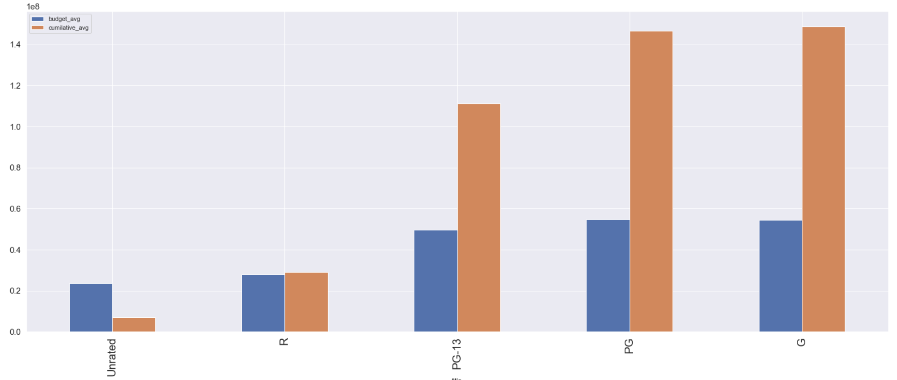
Revenue
Certificate effect

Slide 24
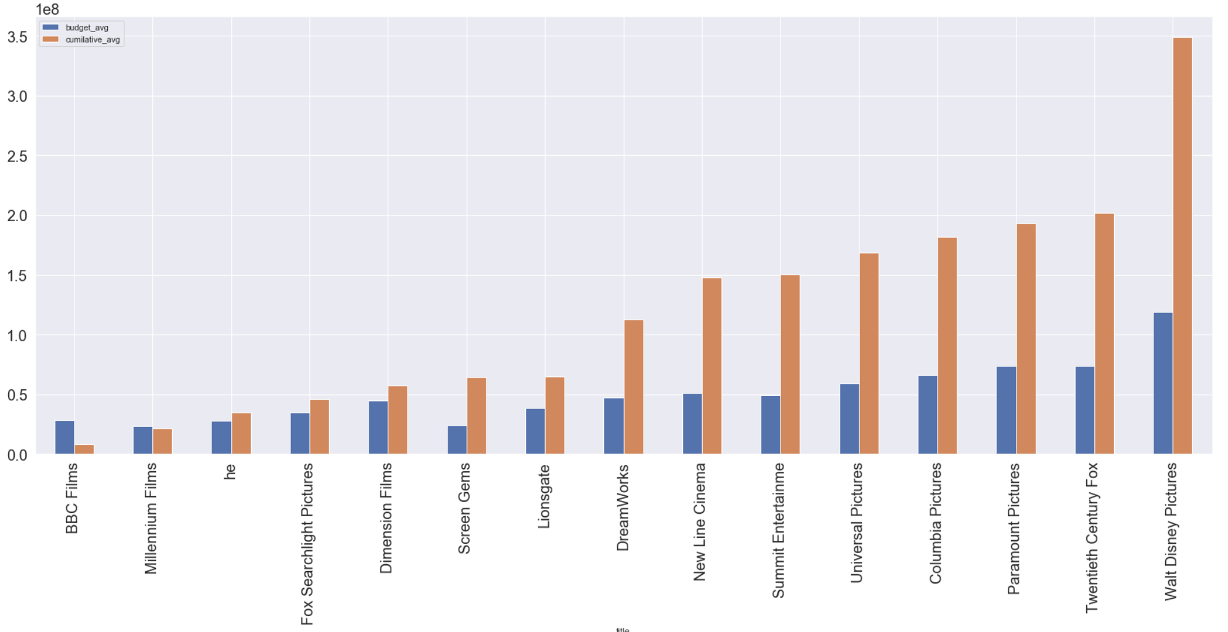
Revenue
Production company effect

Slide 25
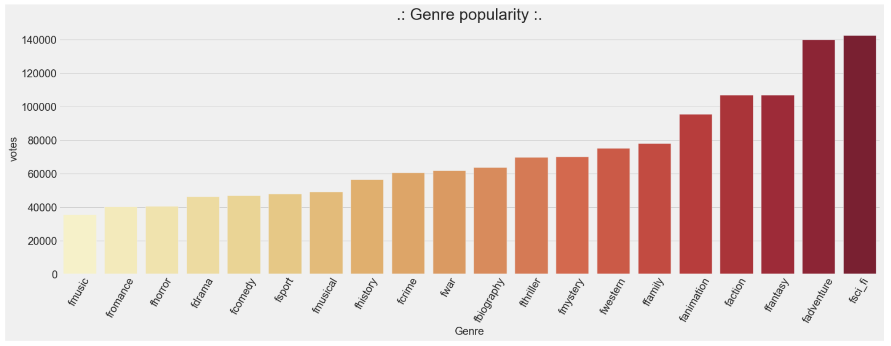
Popularity
Genre effect

Slide 26
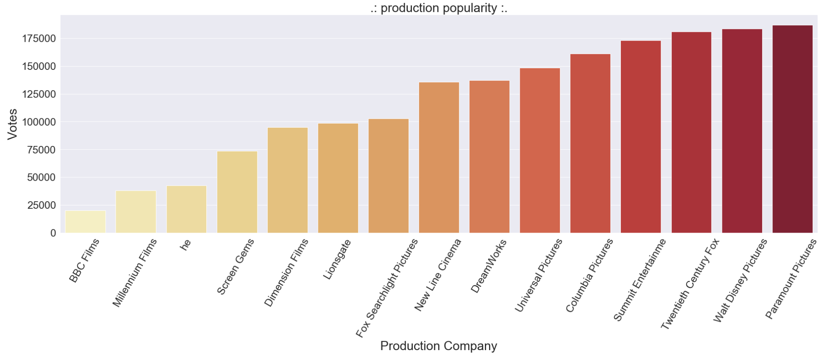
Popularity
Production Company effect

Slide 27
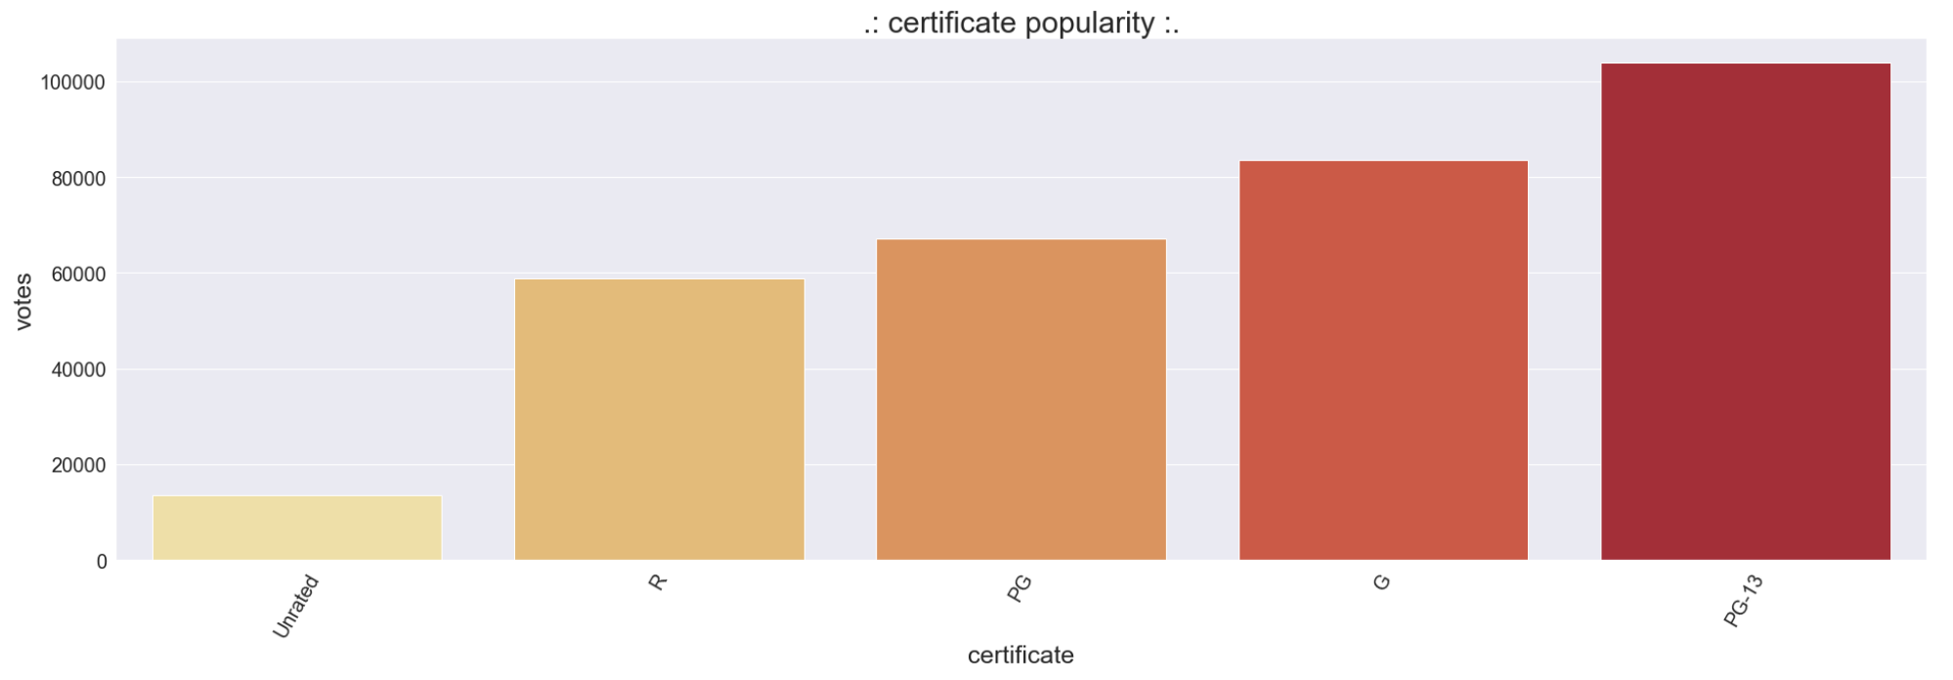
Popularity
Certificate effect

Slide 28
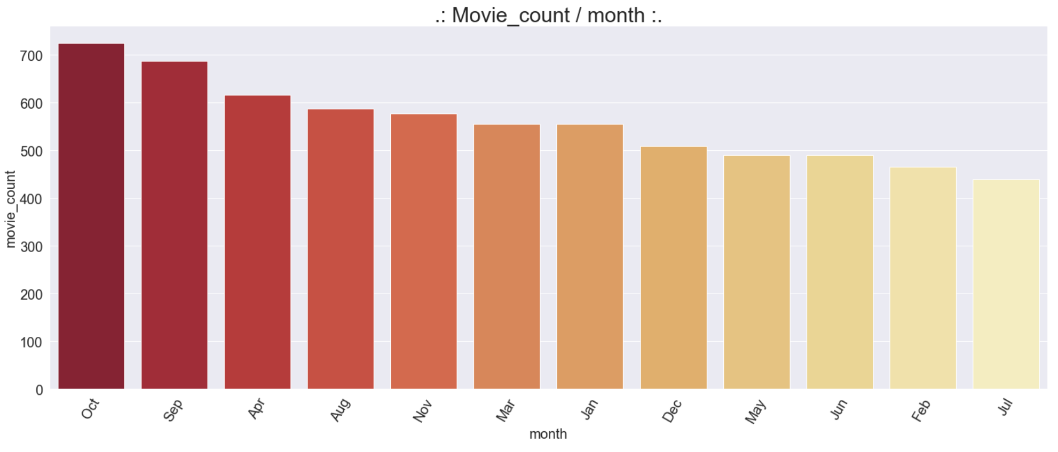
Time
Movie count per month(Avg)

Slide 29
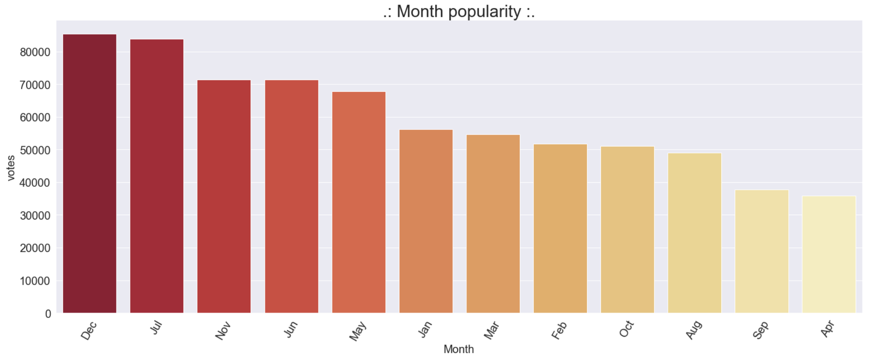
Popularity
Releasing month effect

Slide 30
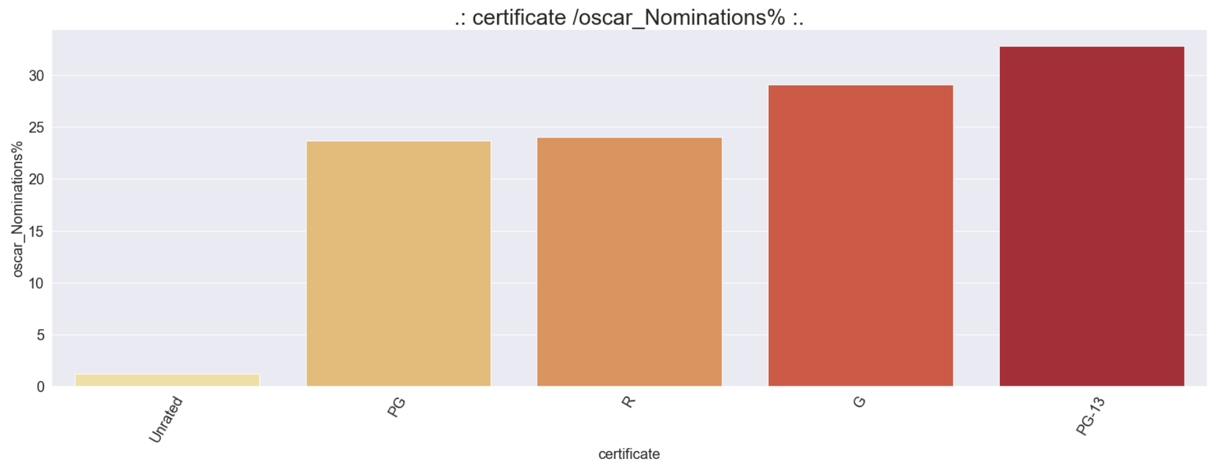
Nominated awards
Certificate effect

Slide 31
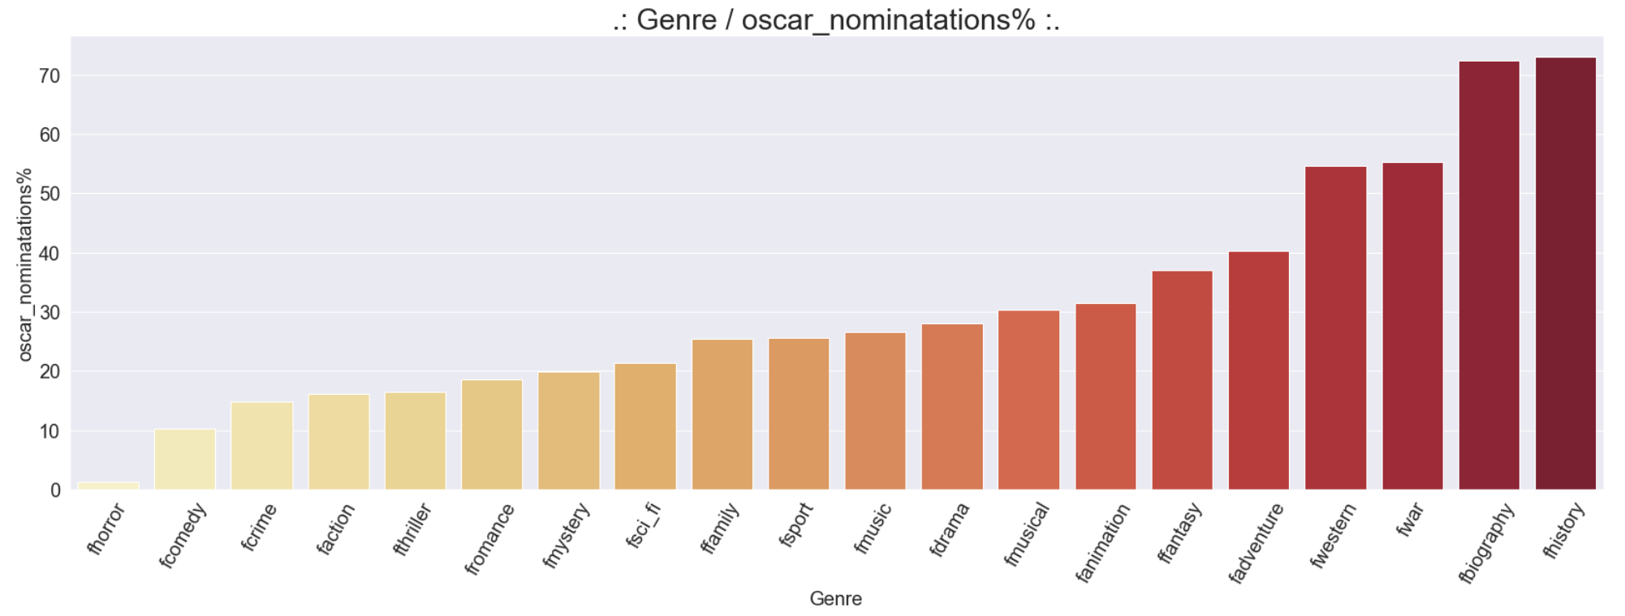
Nominated awards
Genre effect

Slide 32
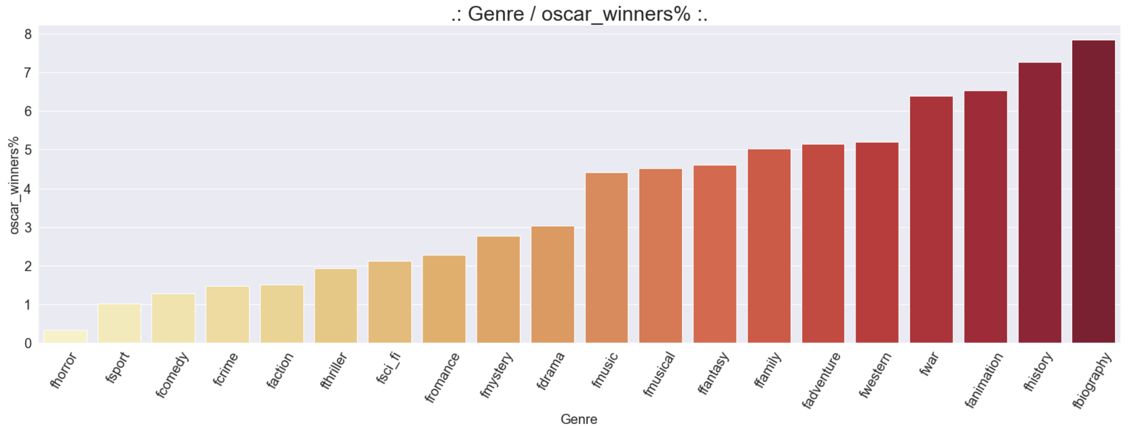
Wining awards
Genre effect

Slide 33
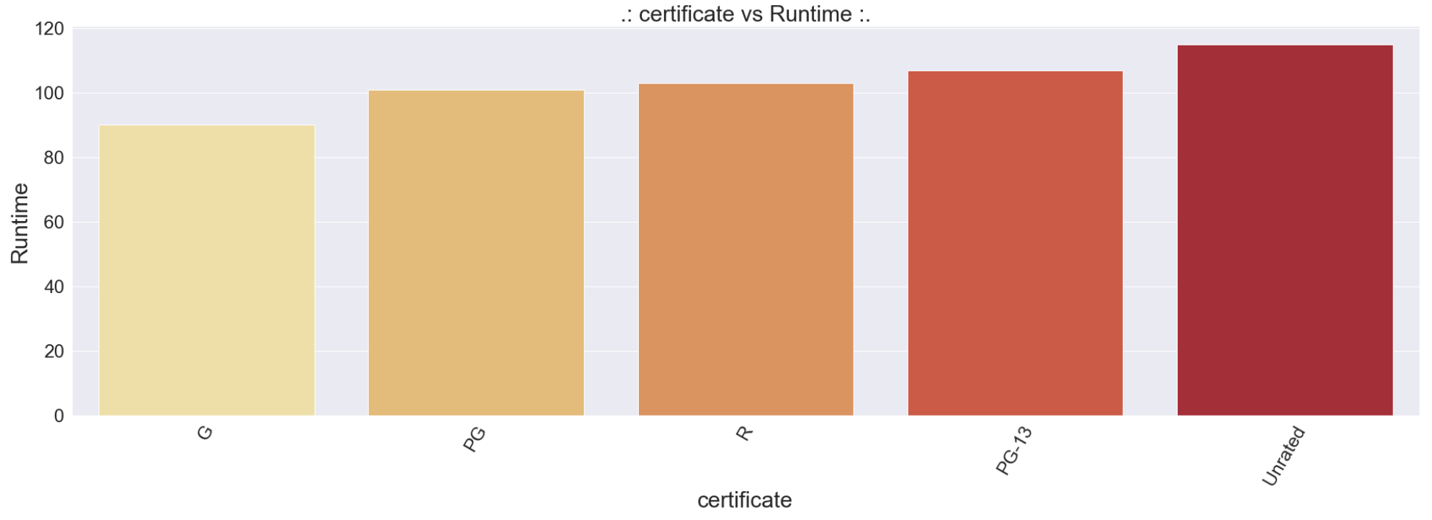
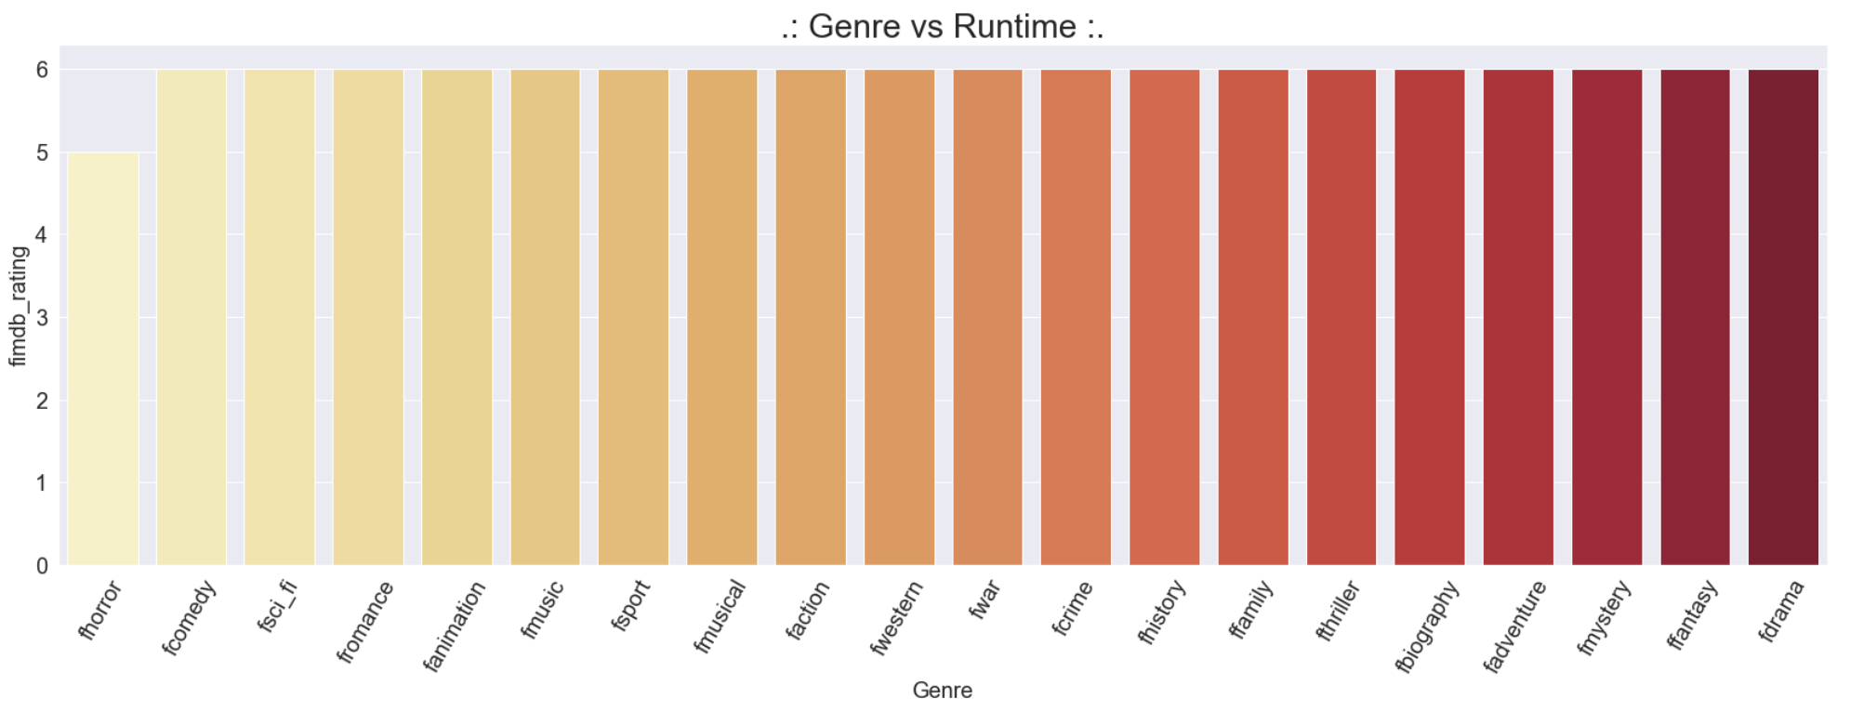
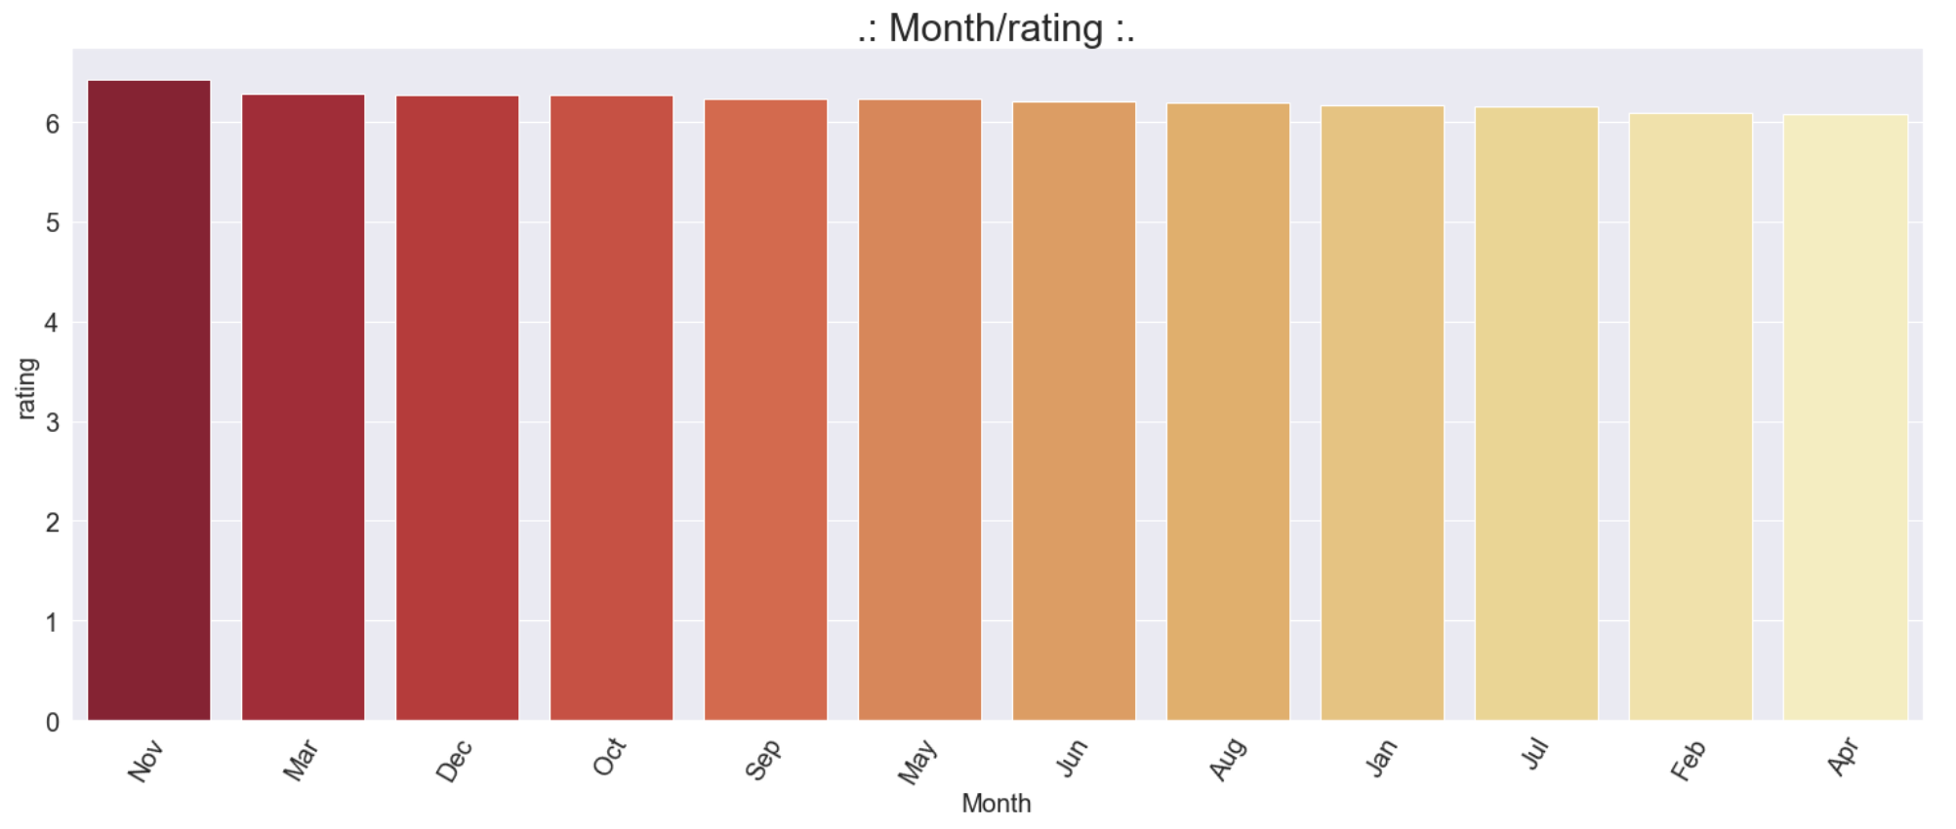
Constant values

Slide 34
Predicting the movies revenue
Highest features correlated with revenue:
Number of votes 0.72
Budget 0.61
Adventure genre 0.39
Best cross validation scores mean was: 74%
Using random forest regressor

Slide 35
Predicting weather the movie will win the Oscar or not.
Highest features correlated with Oscar wining:
Number of votes 0.4
Revenue 0.26
Audience rating 0.21
Best cross validation scores mean was: 98%
Using logistic regression
Confusion matrix
 | Predicted no | Predicted yes
Actual no | 2123 | 44
Actual yes | 14 | 11
Precision: 30%
Recall: 20%

Slide 36
Conclusion
Number of votes is the highest positively correlated value with both revenue and Oscar winning.
We were able to predict a movie revenue with a score of %74.
Oscar winning prediction did not produce satisfactory results
In general history/biography/war has the highest chance of winning an oscar

Slide 37
The End

Slide 38
Presented By
Basmah Alabdullatif Data Scientist
Bader Abanmi Data Scientist
Special thanks to ..
Our mentors
Dr. Ameen Course Lead
Dr. Junaid Course Lead
Fatmah Instructor Assistant
Fahad Instructor Assistant
Our supportive colleagues
Wjdan Domain Expert
Yazeed Domain Expert
Reem Rubber Duck
Sumayah Business Expert
Presented By
Basmah Alabdullatif Data Scientist
Bader Abanmi Data Scientist
Special thanks to ..
Our mentors
Dr. Ameen Course Lead
Dr. Junaid Course Lead
Fatmah Instructor Assistant
Fahad Instructor Assistant
Our supportive colleagues
Wjdan Domain Expert
Yazeed Domain Expert
Reem Rubber Duck
Sumayah Business Expert
Presented By
Basmah Alabdullatif Data Scientist
Bader Abanmi Data Scientist
Special thanks to ..
Our mentors
Dr. Ameen Course Lead
Dr. Junaid Course Lead
Fatmah Instructor Assistant
Fahad Instructor Assistant
Our supportive colleagues
Wjdan Domain Expert
Yazeed Domain Expert
Reem Rubber Duck
Sumayah Business Expert
Presented By
Basmah Alabdullatif Data Scientist
Bader Abanmi Data Scientist
Special thanks to ..
Our mentors
Dr. Ameen Course Lead
Dr. Junaid Course Lead
Fatmah Instructor Assistant
Fahad Instructor Assistant
Our supportive colleagues
Wjdan Domain Expert
Yazeed Domain Expert
Reem Rubber Duck
Sumayah Business Expert
Presented By
Basmah Alabdullatif Data Scientist
Bader Abanmi Data Scientist
Special thanks to ..
Our mentors
Dr. Ameen Course Lead
Dr. Junaid Course Lead
Fatmah Instructor Assistant
Fahad Instructor Assistant
Our supportive colleagues
Wjdan Domain Expert
Yazeed Domain Expert
Reem Rubber Duck
Sumayah Business Expert
Presented By
Basmah Alabdullatif Data Scientist
Bader Abanmi Data Scientist
Special thanks to ..
Our mentors
Dr. Ameen Course Lead
Dr. Junaid Course Lead
Fatmah Instructor Assistant
Fahad Instructor Assistant
Our supportive colleagues
Wjdan Domain Expert
Yazeed Domain Expert
Reem Rubber Duck
Sumayah Business Expert
Presented By
Basmah Alabdullatif Data Scientist
Bader Abanmi Data Scientist
Special thanks to ..
Our mentors
Dr. Ameen Course Lead
Dr. Junaid Course Lead
Fatmah Instructor Assistant
Fahad Instructor Assistant
Our supportive colleagues
Wjdan Domain Expert
Yazeed Domain Expert
Reem Rubber Duck
Sumayah Business Expert
Presented By
Basmah Alabdullatif Data Scientist
Bader Abanmi Data Scientist
Special thanks to ..
Our mentors
Dr. Ameen Course Lead
Dr. Junaid Course Lead
Fatmah Instructor Assistant
Fahad Instructor Assistant
Our supportive colleagues
Wjdan Domain Expert
Yazeed Domain Expert
Reem Rubber Duck
Sumayah Business Expert
Presented By
Basmah Alabdullatif Data Scientist
Bader Abanmi Data Scientist
Special thanks to ..
Our mentors
Dr. Ameen Course Lead
Dr. Junaid Course Lead
Fatmah Instructor Assistant
Fahad Instructor Assistant
Our supportive colleagues
Wjdan Domain Expert
Yazeed Domain Expert
Reem Rubber Duck
Sumayah Business Expert
Presented By
Basmah Alabdullatif Data Scientist
Bader Abanmi Data Scientist
Special thanks to ..
Our mentors
Dr. Ameen Course Lead
Dr. Junaid Course Lead
Fatmah Instructor Assistant
Fahad Instructor Assistant
Our supportive colleagues
Wjdan Domain Expert
Yazeed Domain Expert
Reem Rubber Duck
Sumayah Business Expert
Presented By
Basmah Alabdullatif Data Scientist
Bader Abanmi Data Scientist
Special thanks to ..
Our mentors
Dr. Ameen Course Lead
Dr. Junaid Course Lead
Fatmah Instructor Assistant
Fahad Instructor Assistant
Our supportive colleagues
Wjdan Domain Expert
Yazeed Domain Expert
Reem Rubber Duck
Sumayah Business Expert
Presented By
Basmah Alabdullatif Data Scientist
Bader Abanmi Data Scientist
Special thanks to ..
Our mentors
Dr. Ameen Course Lead
Dr. Junaid Course Lead
Fatmah Instructor Assistant
Fahad Instructor Assistant
Our supportive colleagues
Wjdan Domain Expert
Yazeed Domain Expert
Reem Rubber Duck
Sumayah Business Expert
Presented By
Basmah Alabdullatif Data Scientist
Bader Abanmi Data Scientist
Special thanks to ..
Our mentors
Dr. Ameen Course Lead
Dr. Junaid Course Lead
Fatmah Instructor Assistant
Fahad Instructor Assistant
Our supportive colleagues
Wjdan Domain Expert
Yazeed Domain Expert
Reem Rubber Duck
Sumayah Business Expert
Presented By
Basmah Alabdullatif Data Scientist
Bader Abanmi Data Scientist
Special thanks to ..
Our mentors
Dr. Ameen Course Lead
Dr. Junaid Course Lead
Fatmah Instructor Assistant
Fahad Instructor Assistant
Our supportive colleagues
Wjdan Domain Expert
Yazeed Domain Expert
Reem Rubber Duck
Sumayah Business Expert
Presented By
Basmah Alabdullatif Data Scientist
Bader Abanmi Data Scientist
Special thanks to ..
Our mentors
Dr. Ameen Course Lead
Dr. Junaid Course Lead
Fatmah Instructor Assistant
Fahad Instructor Assistant
Our supportive colleagues
Wjdan Domain Expert
Yazeed Domain Expert
Reem Rubber Duck
Sumayah Business Expert
Presented By
Basmah Alabdullatif Data Scientist
Bader Abanmi Data Scientist
Special thanks to ..
Our mentors
Dr. Ameen Course Lead
Dr. Junaid Course Lead
Fatimah Instructor Assistant
Fahad Instructor Assistant
Our supportive colleagues
Wjdan Domain Expert
Yazeed Domain Expert
Reem Rubber Duck
Sumayah Business Expert

